Slide 1


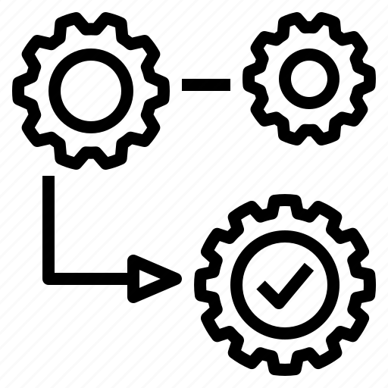





Innovation Opportunity
Gather fragmented info of dispatches (currently in excel, e-mails) in one platform of sales, that allow us to follow up status.
Idea generation
Improve client’s satisfaction, efficiency to identify pending duties in operation, fast actions and corrections.
Idea prioritisation
App/platform that gather status of cargo, documentation and payment.
Status CARGO
Status DOCUMENTS
Status PAYMENT
CLIENT SATISFACTION

Slide 2


Register PO
Planning Production (Compatible with SAP) + estimate date
Logistics make booking.
Logistic fill the status, linked with shipping line booking number
Warning status with deadlines, share with the client
Managed differently per client. Automatic alert to client & Olam
Client’s evaluation and suggestions
Programmed for production
In production
In Origin port
In transit
In destination port
Waiting for clearance
Clearance
+14 days after arrival for any claim
Send docs for approval
Credit Limit
Alert of expire payment, automatic e-mail of reminding to Sales Coordinator and client.
CAD
Alert for sending documentation (9 days after departure)
In Advance
Confirm that deposit was made
Client’s approval
Client’s observations raise
Send original docs
Client received docs

